Slide 1
NumVC
李墨馨 元培学院 1600017837?
黄道吉 元培学院 1600017857

Slide 2
Maximum Clique
Important problem with real-world applications
Network security, scheduling, VLSI design, etc.
Equivalent to other problems
Maximum independent set
Maximum clique
All proven to be NP-hard

Slide 3
Maximum Clique
Terminology
Graph G = (V, E), where V: vertex set, E: edge set
Clique: a subset of V with pairwise adjacent elements
Maximum clique: find the maximum size clique in a graph
We focus on finding a minimum vertex cover instead
A vertex set K is a clique of G iff. V – K is a vertex cover in \bar{G}

Slide 4
NuMVC: intuition
MVC: NP-hard to solve, even to approximate
Exact methods: branch-and-bound; guarantee to optimality but fail to give a solution in reasonable time for large instances
Heuristic methods: optimality not guaranteed, but able to find a (near) optimal solution
Local search algorithms: a heuristic approach
Iteratively solving a k-vertex cover problem
Maintain a candidate solution of size k, exchange vertexes till becoming a VC
Break when time out

Slide 5
NuMVC: novelty
Local search algorithms: drawbacks and improvement
Drawback 1: exchange vertices at the same time, time consuming
Drawback 2: no mechanism to decrease weights of uncovered edges
Improvement 1: decompose into removing and adding stage
Improvement 2: weight forgetting when reaching a threshold

Slide 6
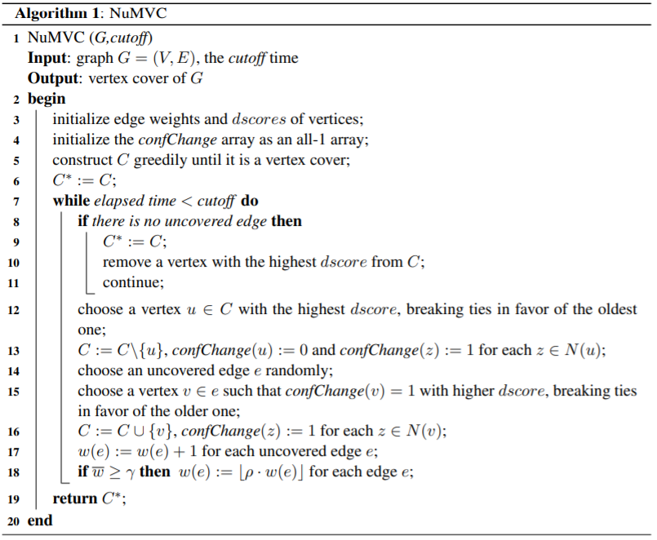
NuMVC: the big picture
Maintain candidate solution C
Update C* if C becomes a VC
Then solve for a (k-1) VC
At each iteration…
Remove a vertex with fewest edges covered by itself
Add a random vertex from an uncovered edge
Update edge weights
Loop till time out

Slide 7
NuMVC: in-depth explanation
Edge weights
Initialized as 1
Increase by 1 each iteration if not covered by candidate solution
Devide by p > 1 when reaching a predefined threshold
dscore of vertex v:
Number of edges covered/uncovered if v added/removed from current solution
A greedy approach: add a vertex with larger dscore to cover more edges; remove a vertex with smaller dscore(in magnitude) to uncover less edges

Slide 8
NuMVC: in-depth explanation
confChange: configuration checking
Try not to visit solutions visited recently
Set the removed vertex’s confChange to 0 s.t. won’t add it back until its neighbor has changed

Slide 9
NuMVC: implementation
Data structures
Graph: N * N array, since we need the complement graph
Uncovered edges: a stack of indexes of edges
v_to_e: list of edges adjacent to v, for fast traversal
Others implemented as integer arrays
Pitfalls:
Random select one when multiple vertices share the same dscore
Otherwise dead loop, and idk why
My modification
Mean edge weight -> sum of edge weight, might be faster

